Slide 1
Programming workshop
Android with Android Studio:
Basic App Design and Development

Slide 2

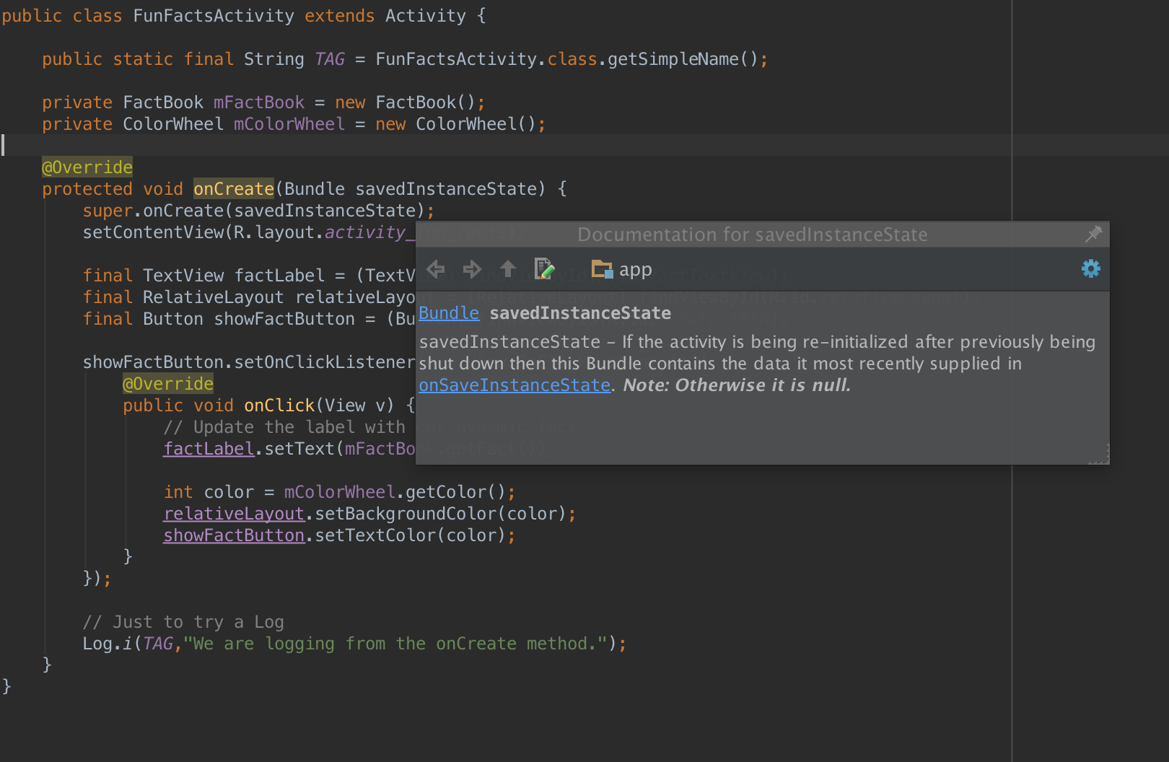
Stop using TextEdit!!!
IDE
Text Editor

Slide 3
JetBrains student program
jetbrains.com/student
Java / Android -- Intellij IDEA
Python -- PyCharm
C / C++ -- Clion
Obj. C / Swift -- App Code
C# -- ReSharper / Rider
Php -- PhpStorm
Ruby -- RubyMine
Javascript -- WebStorm
DBA -- DataGrip

Slide 4
Android Studio
http://developer.android.com/sdk/index.html
Android focused IDE developed by Google
Designed specifically for Android Development
Contains all the Android SDK Tools to design, test, debug, and profile your app.
Powered by the Jetbrains IntellijIDEA platform.
Notes:
Powerful code editing(smart editing, code refractoring and completion, etc)
Rich layout editor Gradle-based build support
Maven support
Template based wizards
Lint tool analysis

Slide 5
Gradle Build System
An advanced build management system based on Groovy.
Yay!!! It’s Open Source!
Gradle combines the power of Ant and Maven.
Designed for large multi-project builds
Flexible approach to dependency management that can reuse existing maven repositories or reference local JARs
introduces a Groovy-based domain-specific language (DSL) instead of the XML form used by Apache Maven
Notes:
Flexible approach to dependency management that can reuse existing maven repositories or reference local JARs
introduces a Groovy-based domain-specific language (DSL) instead of the XML form used by Apache Maven of declaring the project configuration. Gradle uses a directed acyclic graph ("DAG") to determine the order in which tasks can be run.
Gradle was designed for multi-project builds which can grow to be quite large, and supports incremental builds by intelligently determining which parts of the build tree are up-to-date, so that any task dependent upon those parts will not need to be re-executed.

Slide 6
SDK Manager
Separates the SDK tools, platforms, and other components into packages for easy access and management.
Notes:
By default, Android Studio does not check for Android SDK updates. To enable automatic Android SDK checking:
Choose File > Settings > Appearance & Behavior > System Settings > Updates.
Check the Automatically check updates for Android SDK checkbox and select an update channel.
Show the button for it.

Slide 7
Create a Project with Android Studio
In Android Studio, create a new project:
If you don't have a project opened, in the Welcome screen, click New Project.
If you have a project opened, from the File menu, select New Project. The Create New Project screen appears.
Fill out the fields on the screen, and click Next.
Notes:
Start walking them through everything.

Slide 8
DEMO TIME!

Slide 9
Next meeting of JetBrains GWU
April 21st, 2016
Lehman Auditorium (B1270)
5:00 – 7:00 pm
“Learning Python From the Ground Up"
Facebook
https://www.facebook.com/groups/jetbrains.gwu/
Email
jetbrains.gwu@gmail.com
aganezov@gwu.edu

